Slide 1
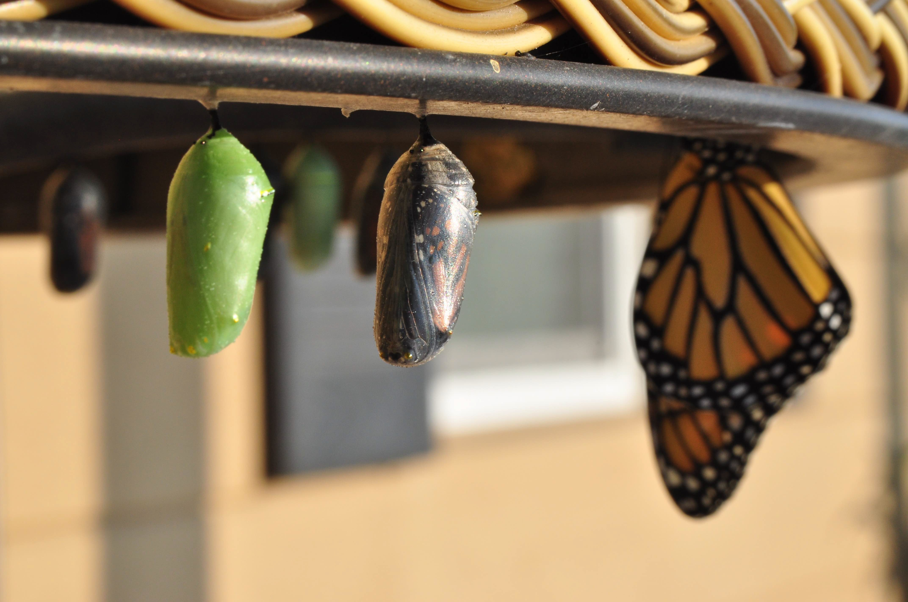
Introduction to Modern Controls
Laplace Transform
Laplace Transform

Slide 2
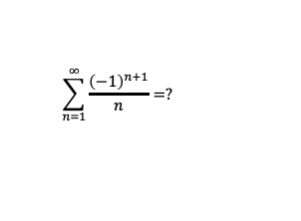
From infinite series to Laplace
$$\sum_{n=1}^{∞}{\frac{{\left(−1\right)}^{n+1}}{n}}=?$$
how does it relate to the Laplace transform?
Laplace Transform

Slide 3
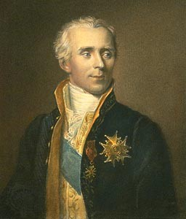
Introduction
Pierre-Simon Laplace (1749-1827)
“the French Newton” or “Newton of France” 13 years younger than Lagrange
studied under Jean le Rond d’Alembert
(co-discovered fundamental theorem of algebra, aka d’Alembert/Gauss theorem)
Laplace Transform

Slide 4
The Laplace approach to ODEs
Laplace Transform
ODE
Algebraic equation
Easy
?
Easy
Arithmetic
Easy
ODE solution
Algebraic solution
Inverse Laplace Transform
Laplace Transform

Slide 5
Sets of numbers and the relevant domains
set: a well-defined collection of distinct objects, e.g., {1, 2, 3}
R: the set of real numbers
C: the set of complex numbers
∈: belong to, e.g., 1 ∈ R
R₊: the set of positive real numbers
≜: defined as, e.g., y(t) ≜ 3x(t) + 1
Laplace Transform

Slide 6
Continuous-time functions
Formal notation:
f : R₊ → R
where the domain of f is in R₊, and the value of f is in R we use f(t) to denote a continuous-time function assume that f(t) = 0 for all t < 0
Laplace Transform

Slide 7
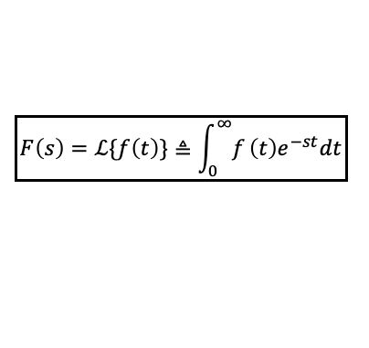
Laplace transform definition
For a continuous-time function
f : R₊ → R
define Laplace Transform:
$$\boxed{F\left(s\right)=ℒ\{f\left(t\right)\}≜\int_{0}^{∞}{f}\left(t\right)e^{−st}dt}$$
s ∈ C
Laplace Transform

Slide 8
Existence: Suﬀicient condition 1
f(t) is piecewise continuous
f(t)
t
Laplace Transform

Slide 9
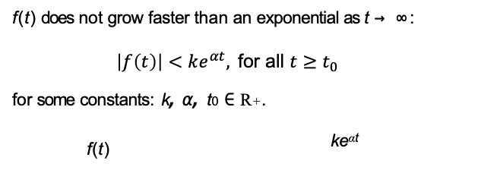
Existence: Suﬀicient condition 2
f(t) does not grow faster than an exponential as t → ∞:
$$\left|f\left(t\right)\right|<ke^{αt}, \text{for} \text{all} t≥t_{0}$$
for some constants: k, α, t₀ ∈ R₊.
f(t) ^{keαt}
t
Laplace Transform

Slide 10
Examples: Exponential
f(t) = e^{−at}, a ∈ C
F(s) = _{s} ¹
+a
Laplace Transform

Slide 11
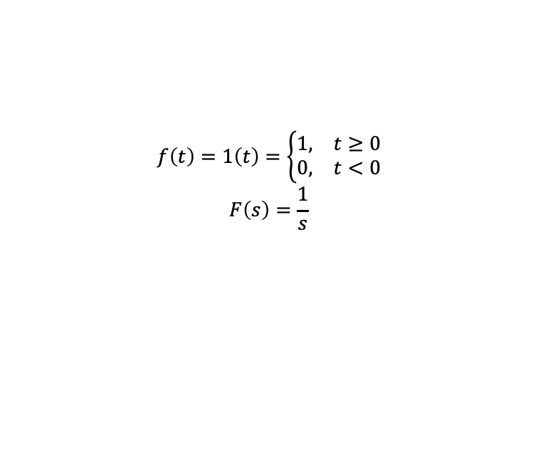
Examples: Exponential
$$f\left(t\right)=1\left(t\right)=\left\{\begin{matrix}1, & t≥0 \\ 0, & t<0\end{matrix}\right.$$
$$F\left(s\right)=\frac{1}{s}$$
Laplace Transform

Slide 12
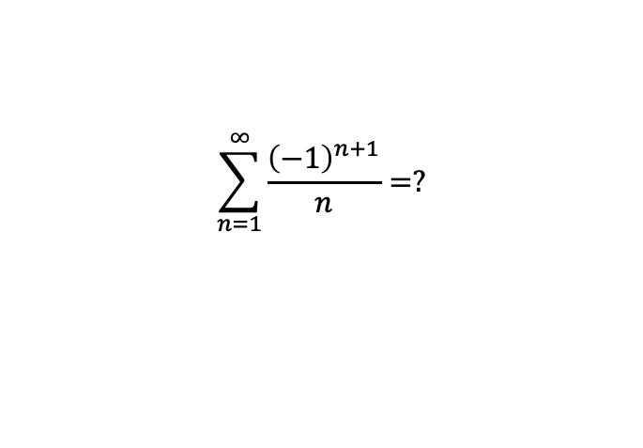
Laplace transform and infinite series
$$\sum_{n=1}^{∞}{\frac{{\left(−1\right)}^{n+1}}{n}}=?$$
Laplace Transform

Slide 13
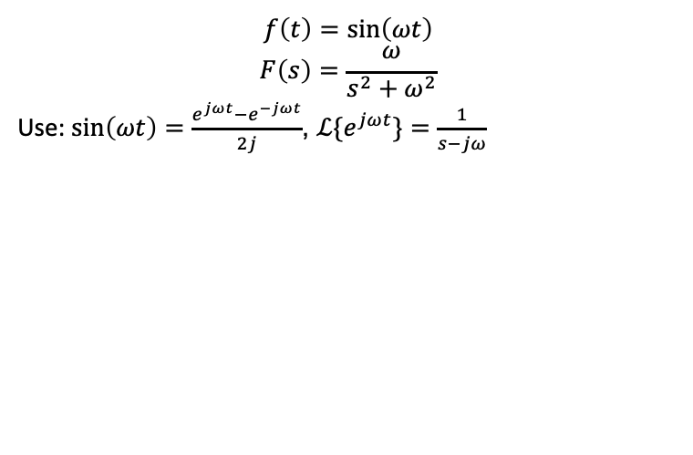
Examples: Sine
$$f\left(t\right)=sin\left(ωt\right)$$
$$F\left(s\right)=\frac{ω}{s^{2}+ω^{2}}$$
Use: $sin\left(ωt\right)=\frac{e^{jωt}−e^{−jωt}}{2j}$, $ℒ\{e^{jωt}\}=\frac{1}{s−jω}$
Laplace Transform

Slide 14
Recall: Euler formula
e^{ja} = cos a + j sin a
Leonhard Euler (04/15/1707 - 09/18/1783):
Swiss mathematician, physicist, astronomer, geographer, logician and engineer
studied under Johann Bernoulli teacher of Lagrange
wrote 380 articles within 25 years at Berlin
produced on average one paper per week at age 67, when almost blind!
Laplace Transform

Slide 15
Examples: Cosine
f(t) = cos(ωt)
F(s) =
s
2 2
s +ω
Laplace Transform

Slide 16
Examples: Dirac impulse
δ(t − T)
T t
a generalized function (formally, a distribution) e.g., consider y˙ − ay = u˙ + bu
▶ if u is a unit step 1(t)
▶ u˙ has a jump at 0
▶ cannot directly evaluate u˙!
Laplace Transform

Slide 17
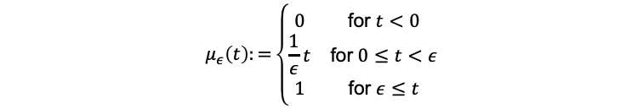
Approximating the unit step
1
0.8
Amplitude
0.6
0.4
0.2
0
2
Time (sec)
-1
0
1
3
4
5
$$μ_{ε}\left(t\right):=\left\{\begin{matrix}0 & \text{for} t<0 \\ \frac{1}{ε}t & \text{for} 0≤t<ε \\ 1 & \text{for} ε≤t\end{matrix}\right.$$
Laplace Transform

Slide 18
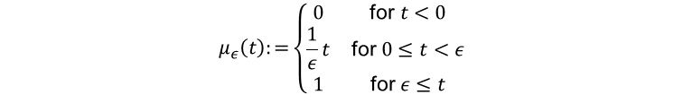
Approximating the unit step
1
0.8
Amplitude
0.6
0.4
0.2
0
2
Time (sec)
-1
0
1
3
4
5
$$μ_{ε}\left(t\right):=\left\{\begin{matrix}0 & \text{for} t<0 \\ \frac{1}{ε}t & \text{for} 0≤t<ε \\ 1 & \text{for} ε≤t\end{matrix}\right.$$
Laplace Transform

Slide 19
Approximating the unit step
1
0.8
Amplitude
0.6
0.4
0.2
0
2
Time (sec)
-1
0
1
3
4
5
$$μ_{ε}\left(t\right):=\left\{\begin{matrix}0 & \text{for} t<0 \\ \frac{1}{ε}t & \text{for} 0≤t<ε \\ 1 & \text{for} ε≤t\end{matrix}\right.$$
Mod Ctrl Intro (w Matlab & Python)
Laplace Transform
19 / 46

Slide 20
Approximating the unit step
1
0.8
Amplitude
0.6
0.4
0.2
0
2
Time (sec)
-1
0
1
3
4
5
$$μ_{ε}\left(t\right):=\left\{\begin{matrix}0 & \text{for} t<0 \\ \frac{1}{ε}t & \text{for} 0≤t<ε \\ 1 & \text{for} ε≤t\end{matrix}\right.$$
Laplace Transform

Slide 21
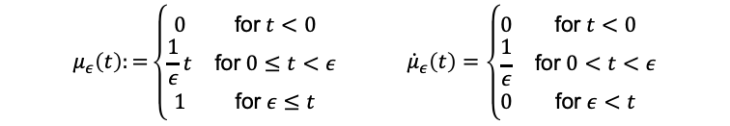
Approximating 1˙(t)
1
1
0.8
0.8
Amplitude
0.6
Amplitude
0.6
0.4
0.4
0.2
0.2
0
-1
0 1
2
Time (sec)
3
4
5
0
-1
0
1
2
Time (sec)
3
4
5
$$μ_{ε}\left(t\right):=\left\{\begin{matrix}0 & \text{for} t<0 \\ \frac{1}{ε}t & \text{for} 0≤t<ε \\ 1 & \text{for} ε≤t\end{matrix}\right. {\dot{μ}}_{ε}\left(t\right)=\left\{\begin{matrix}0 & \text{for} t<0 \\ \frac{1}{ε} & \text{for} 0<t<ε \\ 0 & \text{for} ε<t\end{matrix}\right.$$
Laplace Transform

Slide 22
Approximating 1˙(t)
1
2
0.8
1.5
Amplitude
0.6
Amplitude
1
0.4
0.2
0.5
0
-1
0 1
2
Time (sec)
3
4
5
0
-1
0
1
2
Time (sec)
3
4
5
$$μ_{ε}\left(t\right):=\left\{\begin{matrix}0 & \text{for} t<0 \\ \frac{1}{ε}t & \text{for} 0≤t<ε \\ 1 & \text{for} ε≤t\end{matrix}\right. {\dot{μ}}_{ε}\left(t\right)=\left\{\begin{matrix}0 & \text{for} t<0 \\ \frac{1}{ε} & \text{for} 0<t<ε \\ 0 & \text{for} ε<t\end{matrix}\right.$$
Laplace Transform

Slide 23
Approximating 1˙(t)
1
7
0.8
6
5
Amplitude
0.6
Amplitude
4
0.4
3
2
0.2
1
0
-1
0 1
2
Time (sec)
3
4
5
0
-1
0
1
2
Time (sec)
3 4
5
$$μ_{ε}\left(t\right):=\left\{\begin{matrix}0 & \text{for} t<0 \\ \frac{1}{ε}t & \text{for} 0≤t<ε \\ 1 & \text{for} ε≤t\end{matrix}\right. {\dot{μ}}_{ε}\left(t\right)=\left\{\begin{matrix}0 & \text{for} t<0 \\ \frac{1}{ε} & \text{for} 0<t<ε \\ 0 & \text{for} ε<t\end{matrix}\right.$$
Laplace Transform

Slide 24
Approximating 1˙(t)
1
20
0.8
15
Amplitude
0.6
Amplitude
10
0.4
0.2
5
0
-1
0 1
2
Time (sec)
3
4
5
0
-1
0
1
2
Time (sec)
3 4
5
$$μ_{ε}\left(t\right):=\left\{\begin{matrix}0 & \text{for} t<0 \\ \frac{1}{ε}t & \text{for} 0≤t<ε \\ 1 & \text{for} ε≤t\end{matrix}\right. {\dot{μ}}_{ε}\left(t\right)=\left\{\begin{matrix}0 & \text{for} t<0 \\ \frac{1}{ε} & \text{for} 0<t<ε \\ 0 & \text{for} ε<t\end{matrix}\right.$$
Laplace Transform

Slide 25
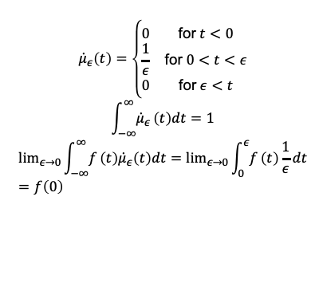
Properties of the first-order approximation
$${\dot{μ}}_{ε}\left(t\right)=\left\{\begin{matrix}0 & \text{for} t<0 \\ \frac{1}{ε} & \text{for} 0<t<ε \\ 0 & \text{for} ε<t\end{matrix}\right.$$
$$\int_{−∞}^{∞}{{\dot{μ}}_{ε}}\left(t\right)dt=1$$
$$\lim_{ε→0}\int_{−∞}^{∞}{f}\left(t\right){\dot{μ}}_{ε}\left(t\right)dt=\lim_{ε→0}\int_{0}^{ε}{f}\left(t\right)\frac{1}{ε}dt=f\left(0\right)$$
20
15
Amplitude
10
5
0
-1
0
1
2
Time (sec)
3
4
5
Laplace Transform

Slide 26
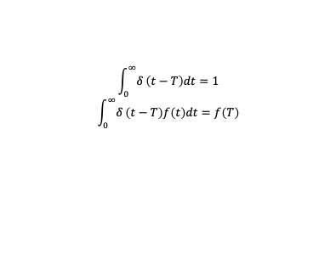
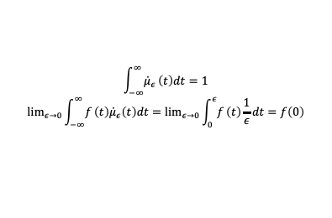
General Dirac impulse properties
20
δ(t − T)
15
Amplitude
10
5
0
-1
0
1
2
Time (sec)
3
4
5
t
$$\int_{−∞}^{∞}{{\dot{μ}}_{ε}}\left(t\right)dt=1$$
$$\lim_{ε→0}\int_{−∞}^{∞}{f}\left(t\right){\dot{μ}}_{ε}\left(t\right)dt=\lim_{ε→0}\int_{0}^{ε}{f}\left(t\right)\frac{1}{ε}dt=f\left(0\right)$$
$$\int_{0}^{∞}{δ}\left(t−T\right)dt=1$$
$$\int_{0}^{∞}{δ}\left(t−T\right)f\left(t\right)dt=f\left(T\right)$$
Laplace Transform

Slide 27
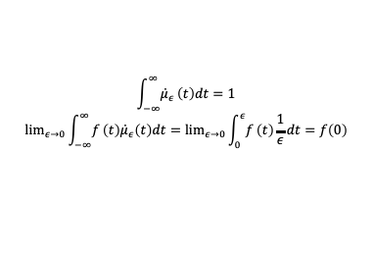
Challenges with the first-order approximation
20
15
Amplitude
µ˙ _{ϵ}(t) is piecewise-continuous and not fully differentiable
10
5
µ (t) ≈ 1(t) is only first-order
ϵ
differentiable cannot handle, e.g.,
¨y + 2y˙ − ay = u¨ + 3u˙ + bu
0
-1
0
1
2 3
Time (sec)
4
5
$$\int_{−∞}^{∞}{{\dot{μ}}_{ε}}\left(t\right)dt=1$$
$$\lim_{ε→0}\int_{−∞}^{∞}{f}\left(t\right){\dot{μ}}_{ε}\left(t\right)dt=\lim_{ε→0}\int_{0}^{ε}{f}\left(t\right)\frac{1}{ε}dt=f\left(0\right)$$
Laplace Transform

Slide 28
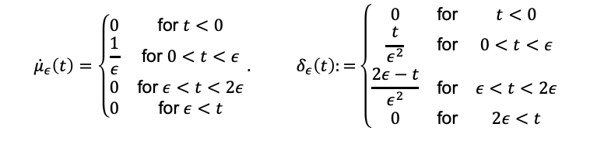
Second-order approximation of 1˙(t)
1
1
0.9
0.8
0.8
0.7
Amplitude
0.6
Amplitude
0.6
0.5
0.4
0.4
0.3
0.2
0.2
0.1
0
-1
0 1
2 3
Time (sec)
4
5
0
0
1
2
3
4
5
Time (sec)
$${\dot{μ}}_{ε}\left(t\right)=\left\{\begin{matrix}0 & \text{for} t<0 \\ \frac{1}{ε} & \text{for} 0<t<ε \\ 0 & \text{for} ε<t<2ε \\ 0 & \text{for} ε<t\end{matrix}\right.. δ_{ε}\left(t\right):=\left\{\begin{matrix}0 & \text{for} & t<0 \\ \frac{t}{ε^{2}} & \text{for} & 0<t<ε \\ \frac{2ε−t}{ε^{2}} & \text{for} & ε<t<2ε \\ 0 & \text{for} & 2ε<t\end{matrix}\right.$$
Laplace Transform

Slide 29
Second-order approximation of 1˙(t)
2
2
1.8
1.6
1.5
1.4
1.2
Amplitude
Amplitude
1
1
0.8
0.6
0.5
0.4
0.2
0
-1
0 1
2 3
Time (sec)
4
5
0
0
1
2
3
4
5
Time (sec)
$${\dot{μ}}_{ε}\left(t\right)=\left\{\begin{matrix}0 & \text{for} t<0 \\ \frac{1}{ε} & \text{for} 0<t<ε \\ 0 & \text{for} ε<t<2ε \\ 0 & \text{for} ε<t\end{matrix}\right.. δ_{ε}\left(t\right):=\left\{\begin{matrix}0 & \text{for} & t<0 \\ \frac{t}{ε^{2}} & \text{for} & 0<t<ε \\ \frac{2ε−t}{ε^{2}} & \text{for} & ε<t<2ε \\ 0 & \text{for} & 2ε<t\end{matrix}\right.$$
Mod Ctrl Intro (w Matlab & Python)
Laplace Transform
29 / 46

Slide 30
Second-order approximation of 1˙(t)
7
4
6
3.5
5
3
Amplitude
4
Amplitude
2.5
2
3
1.5
2
1
1
0.5
0
-1
0
1
2 3
Time (sec)
4
5
0
0
1
2
3
4
5
Time (sec)
$${\dot{μ}}_{ε}\left(t\right)=\left\{\begin{matrix}0 & \text{for} t<0 \\ \frac{1}{ε} & \text{for} 0<t<ε \\ 0 & \text{for} ε<t<2ε \\ 0 & \text{for} ε<t\end{matrix}\right.. δ_{ε}\left(t\right):=\left\{\begin{matrix}0 & \text{for} & t<0 \\ \frac{t}{ε^{2}} & \text{for} & 0<t<ε \\ \frac{2ε−t}{ε^{2}} & \text{for} & ε<t<2ε \\ 0 & \text{for} & 2ε<t\end{matrix}\right.$$
Laplace Transform

Slide 31
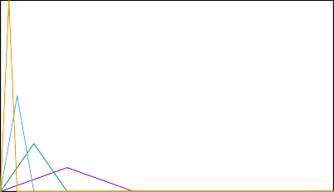
Second-order approximation of 1˙(t)
20
8
7
15
6
Amplitude
Amplitude
5
10
4
3
5
2
1
0
-1
0 1
2 3
Time (sec)
4
5
0
0
1
2
3
4
5
Time (sec)
$${\dot{μ}}_{ε}\left(t\right)=\left\{\begin{matrix}0 & \text{for} t<0 \\ \frac{1}{ε} & \text{for} 0<t<ε \\ 0 & \text{for} ε<t<2ε \\ 0 & \text{for} ε<t\end{matrix}\right.. δ_{ε}\left(t\right):=\left\{\begin{matrix}0 & \text{for} & t<0 \\ \frac{t}{ε^{2}} & \text{for} & 0<t<ε \\ \frac{2ε−t}{ε^{2}} & \text{for} & ε<t<2ε \\ 0 & \text{for} & 2ε<t\end{matrix}\right.$$
Laplace Transform

Slide 32
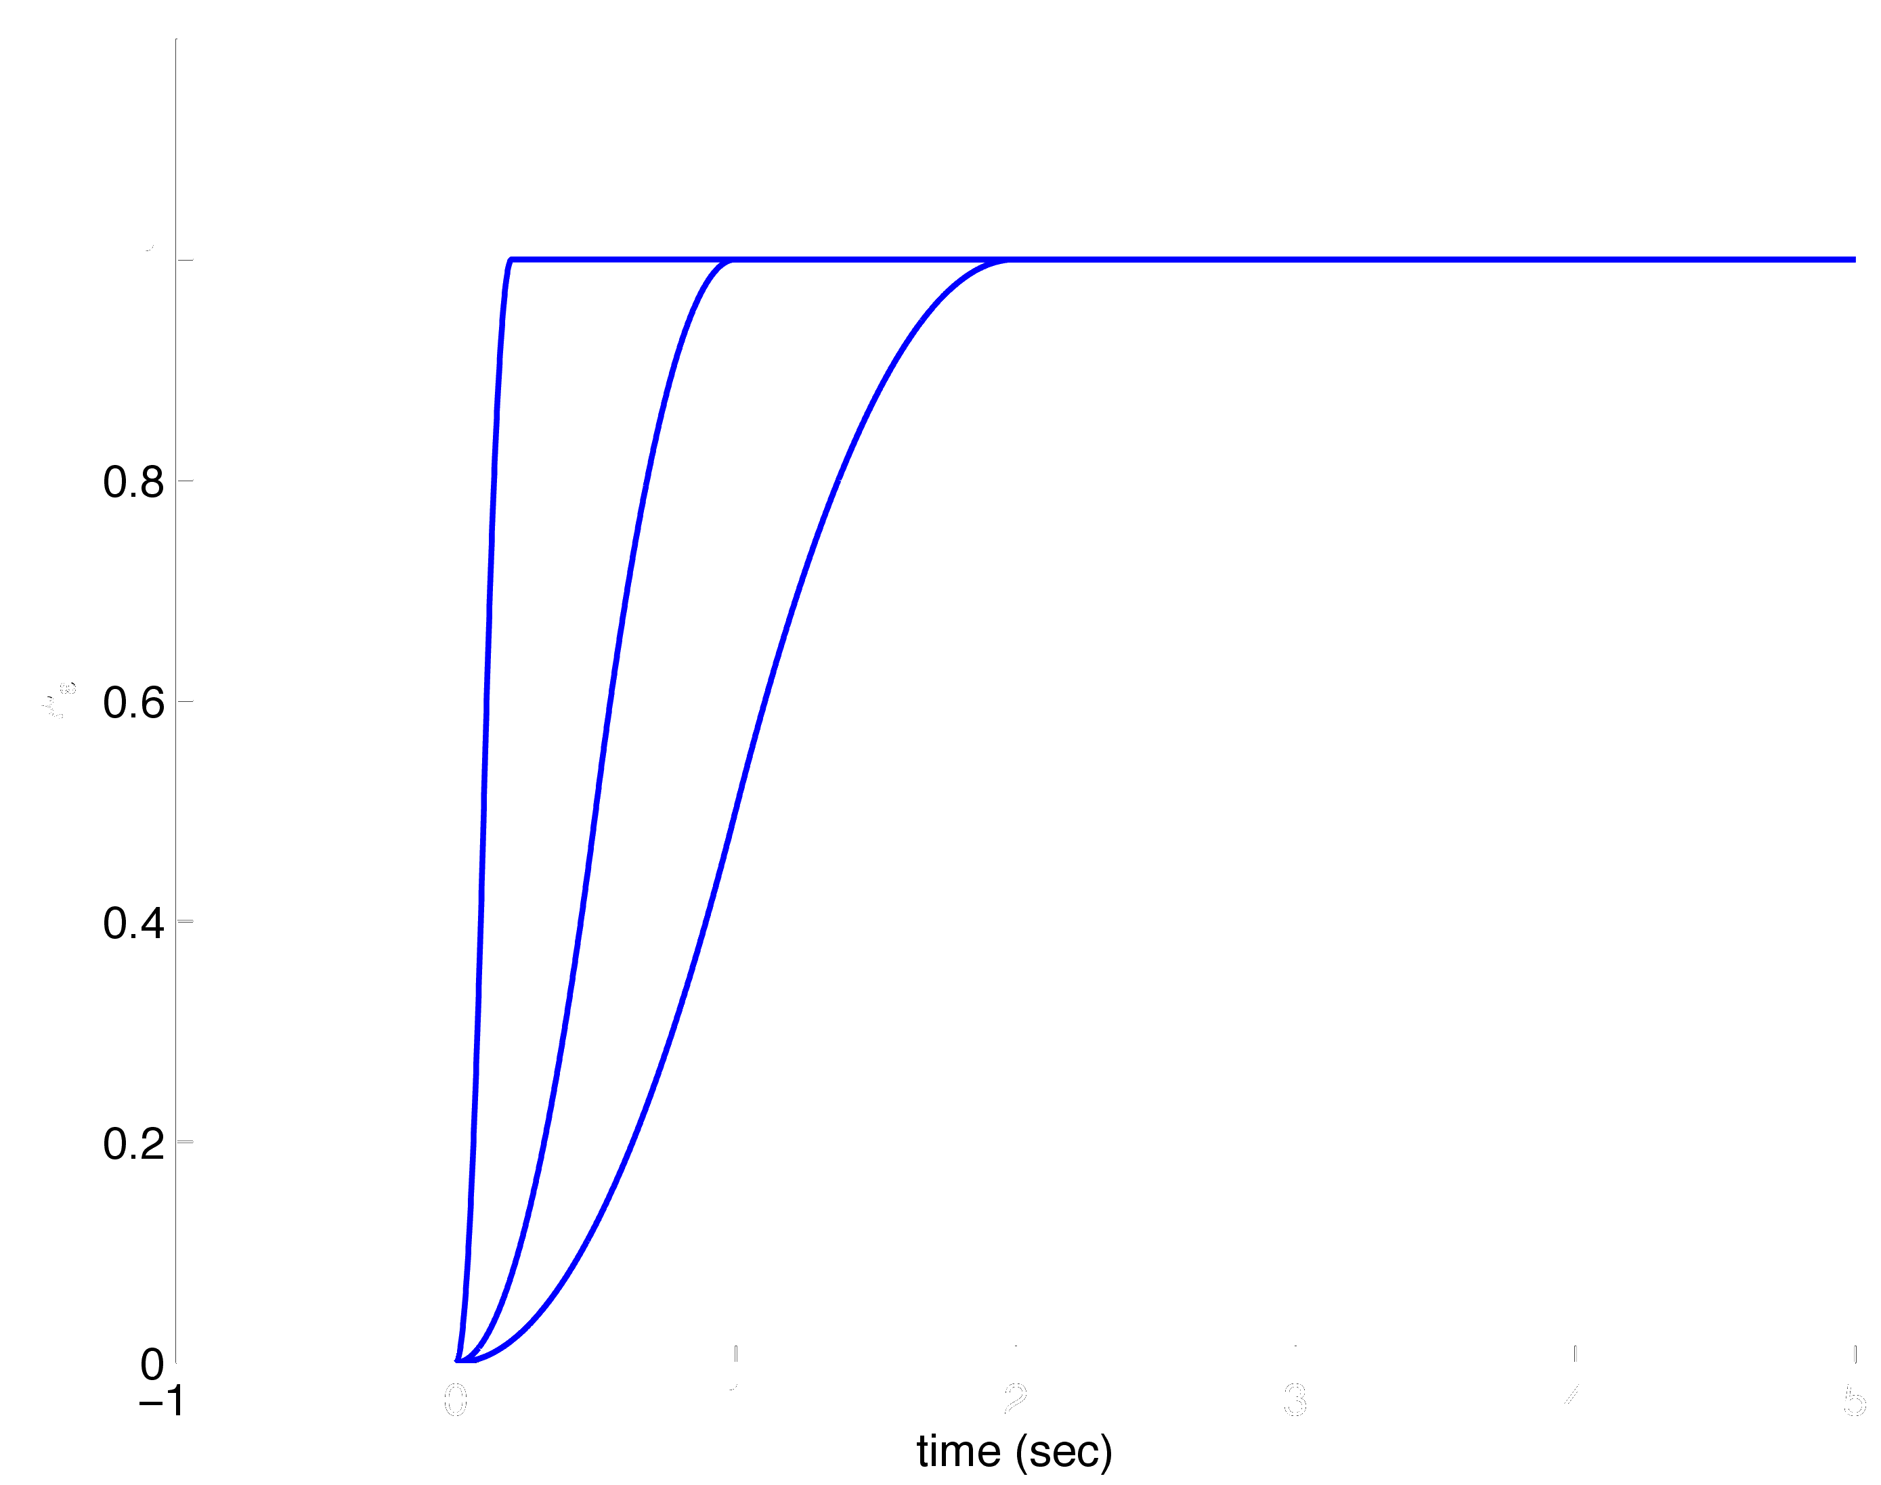
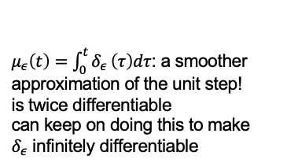
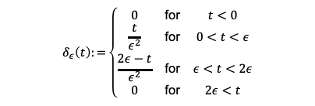
Second-order approximation of 1(t)
16
14
12
10
8
6
4
2
0
delta
0
1
2
3
4
5
Time (sec)
$$δ_{ε}\left(t\right):=\left\{\begin{matrix}0 & \text{for} & t<0 \\ \frac{t}{ε^{2}} & \text{for} & 0<t<ε \\ \frac{2ε−t}{ε^{2}} & \text{for} & ε<t<2ε \\ 0 & \text{for} & 2ε<t\end{matrix}\right.$$
$μ_{ε}\left(t\right)=\int_{0}^{t}{δ_{ε}}\left(τ\right)dτ$: a smoother approximation of the unit step!
is twice differentiable
can keep on doing this to make
$δ_{ε}$ infinitely differentiable
Laplace Transform

Slide 33
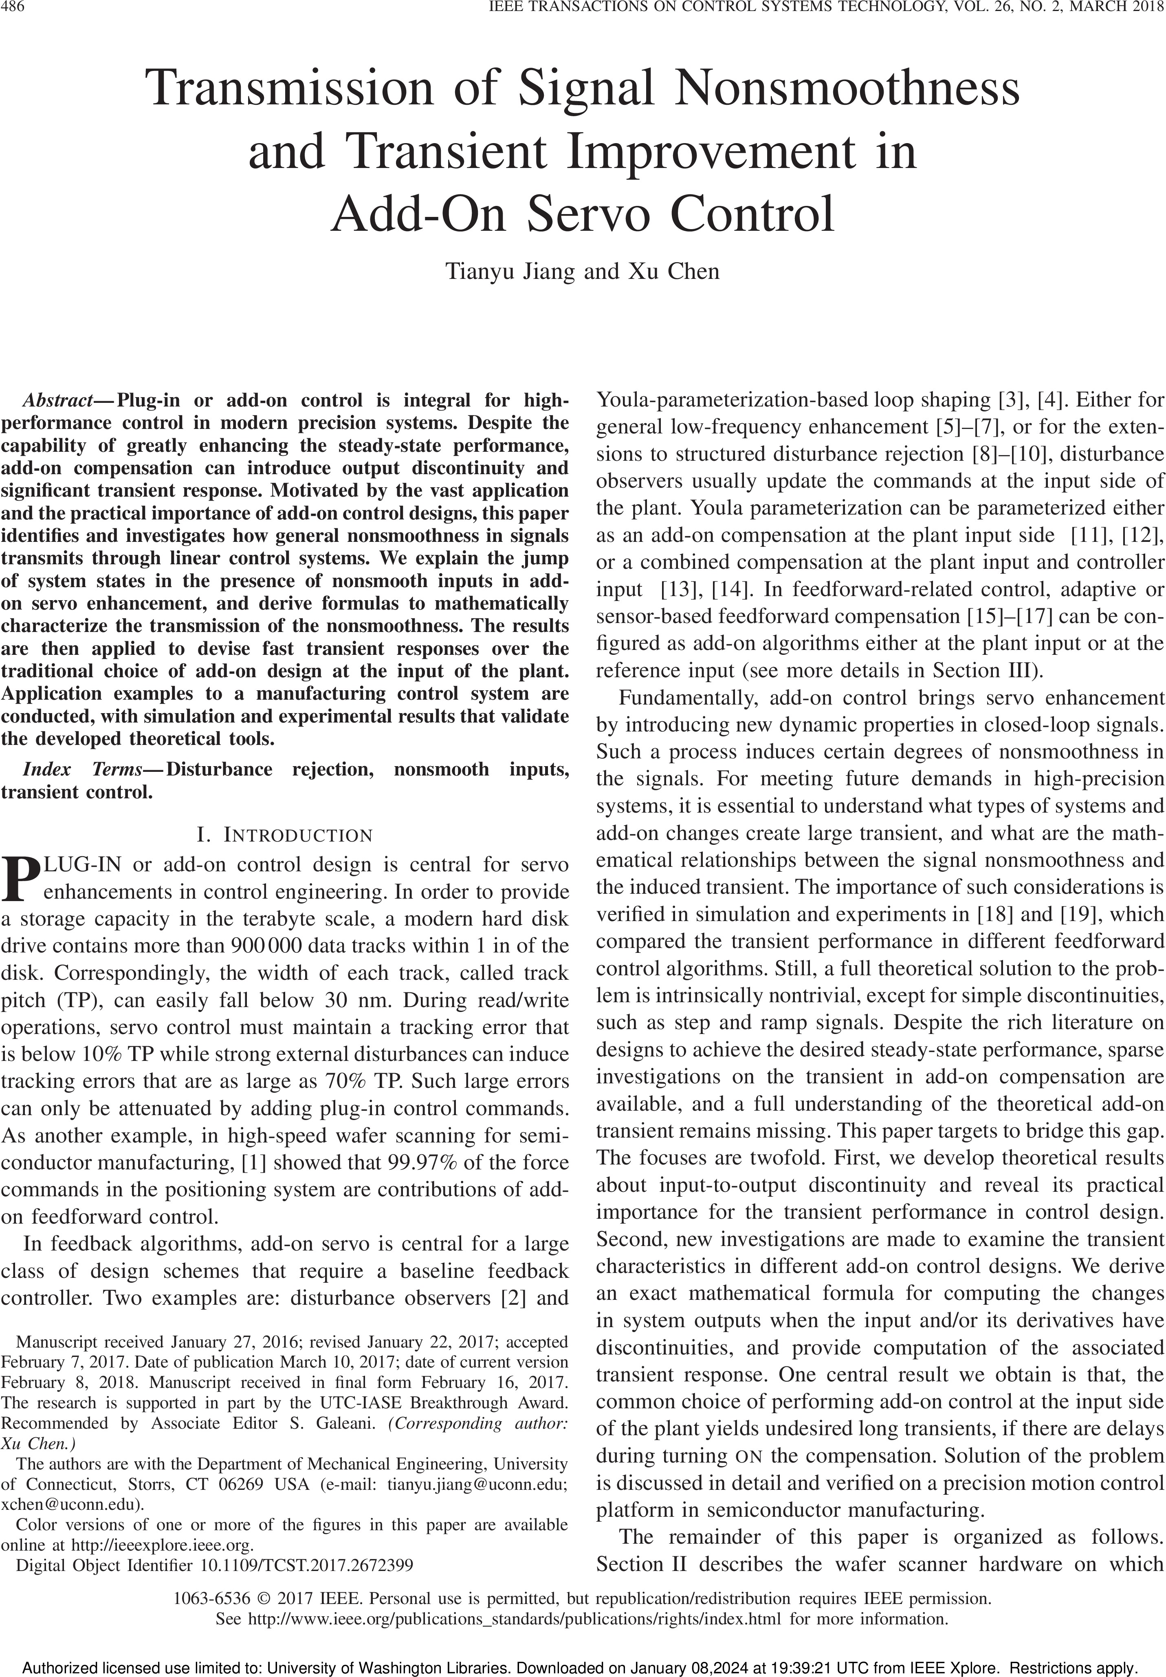
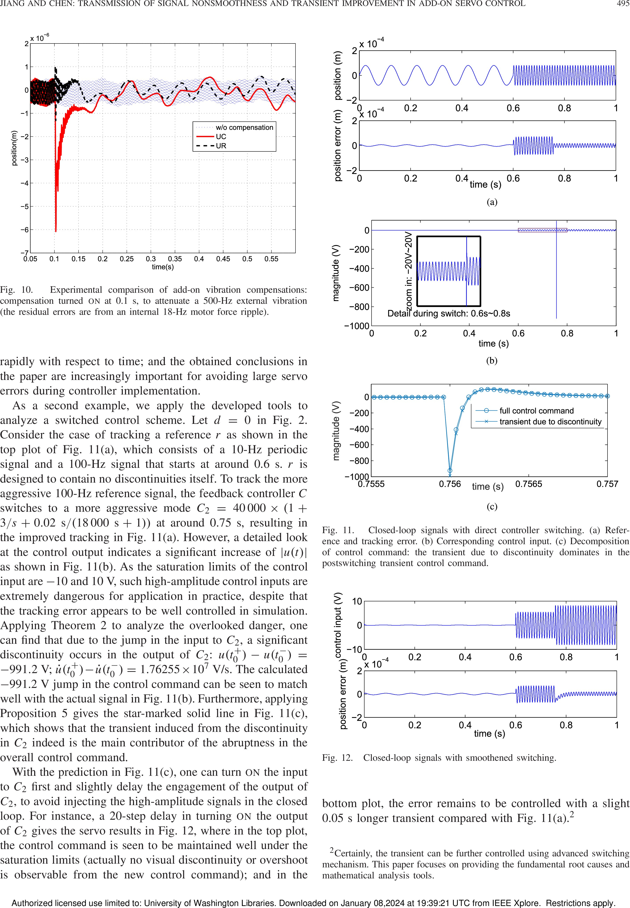
Application of the concept
Laplace Transform

Slide 34

Application of the concept
Laplace Transform

Slide 35
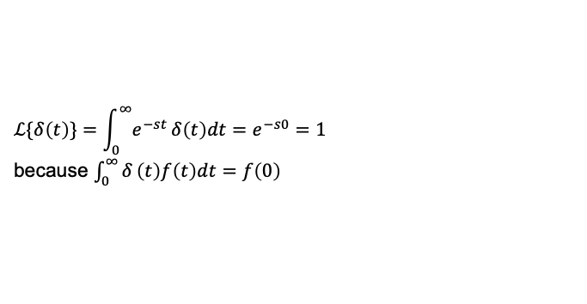
Laplace transform of the Dirac impulse
$$ℒ\{δ\left(t\right)\}=\int_{0}^{∞}{e^{−st}}δ\left(t\right)dt=e^{−s0}=1$$
because $\int_{0}^{∞}{δ}\left(t\right)f\left(t\right)dt=f\left(0\right)$
Laplace Transform

Slide 36
Properties of Laplace transform
Laplace Transform

Slide 37
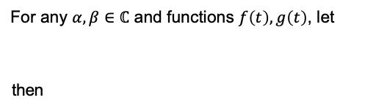
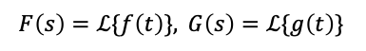
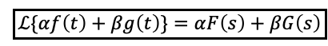
Linearity
For any $α,β∈ℂ$ and functions $f\left(t\right),g\left(t\right)$, let
then
$$F\left(s\right)=ℒ\{f\left(t\right)\}, G\left(s\right)=ℒ\{g\left(t\right)\}$$
$$\boxed{ℒ\{αf\left(t\right)+βg\left(t\right)\}=αF\left(s\right)+βG\left(s\right)}$$
Laplace Transform

Slide 38
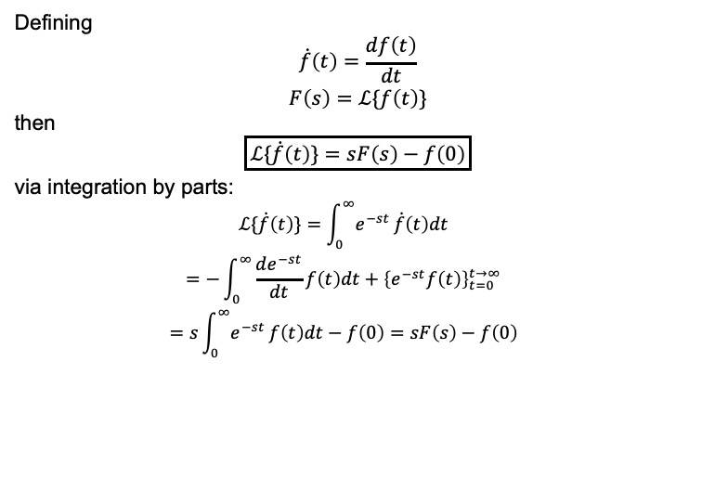
Differentiation
Defining
$$\dot{f}\left(t\right)=\frac{df\left(t\right)}{dt}$$
$$F\left(s\right)=ℒ\{f\left(t\right)\}$$
then
$$\boxed{ℒ\{\dot{f}\left(t\right)\}=sF\left(s\right)−f\left(0\right)}$$
via integration by parts:
$$\begin{matrix} & ℒ\{\dot{f}\left(t\right)\}=\int_{0}^{∞}{e^{−st}}\dot{f}\left(t\right)dt \\ & =−\int_{0}^{∞}{\frac{de^{−st}}{dt}}f\left(t\right)dt+{\left\{e^{−st}f\left(t\right)\right\}}_{t=0}^{t→∞} \\ & =s\int_{0}^{∞}{e^{−st}}f\left(t\right)dt−f\left(0\right)=sF\left(s\right)−f\left(0\right)\end{matrix}$$
Laplace Transform

Slide 39
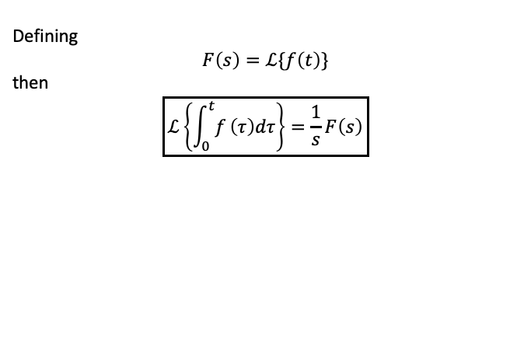
Integration
Defining
$$F\left(s\right)=ℒ\{f\left(t\right)\}$$
then
$$\boxed{ℒ\left\{\int_{0}^{t}{f}\left(τ\right)dτ\right\}=\frac{1}{s}F\left(s\right)}$$
Laplace Transform

Slide 40
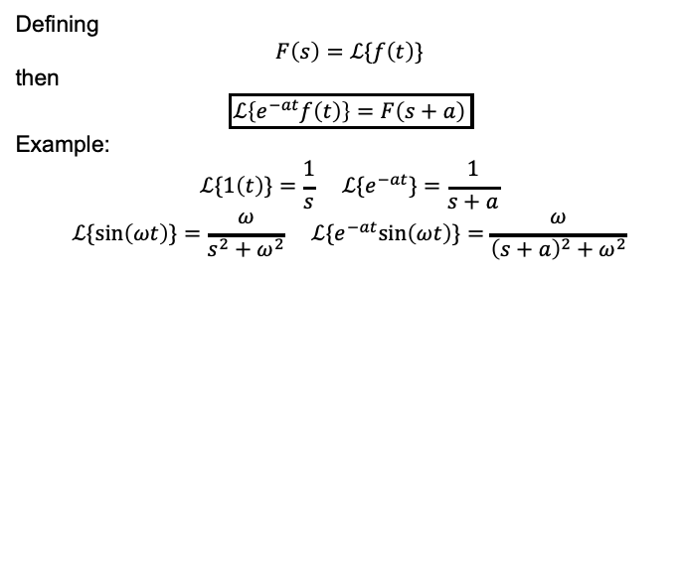
Multiplication by e^{−at}
Defining
$$F\left(s\right)=ℒ\{f\left(t\right)\}$$
then
$$\boxed{ℒ\left\{e^{−at}f\left(t\right)\right\}=F\left(s+a\right)}$$
Example:
$$ℒ\{1\left(t\right)\}=\frac{1}{s} ℒ\{e^{−at}\}=\frac{1}{s+a}$$
$$ℒ\{sin\left(ωt\right)\}=\frac{ω}{s^{2}+ω^{2}} ℒ\{e^{−at}sin\left(ωt\right)\}=\frac{ω}{{\left(s+a\right)}^{2}+ω^{2}}$$
Laplace Transform

Slide 41
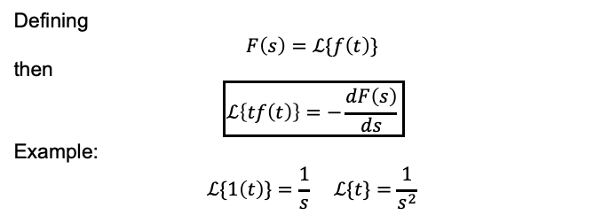
Multiplication by t
Defining
$$F\left(s\right)=ℒ\{f\left(t\right)\}$$
then
$$\boxed{ℒ\left\{tf\left(t\right)\right\}=−\frac{dF\left(s\right)}{ds}}$$
Example:
$$ℒ\{1\left(t\right)\}=\frac{1}{s} ℒ\{t\}=\frac{1}{s^{2}}$$
Laplace Transform

Slide 42
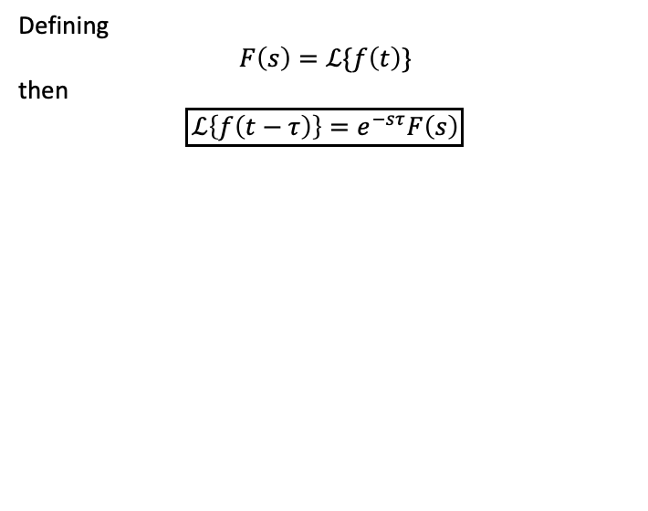
Time delay τ
Defining
$$F\left(s\right)=ℒ\{f\left(t\right)\}$$
then
$$\boxed{ℒ\left\{f\left(t−τ\right)\right\}=e^{−sτ}F\left(s\right)}$$
Laplace Transform

Slide 43
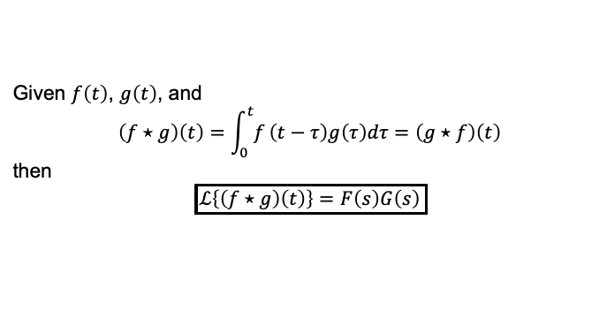
Convolution
Given $f\left(t\right)$, $g\left(t\right)$, and
$$\left(f⋆g\right)\left(t\right)=\int_{0}^{t}{f}\left(t−τ\right)g\left(τ\right)dτ=\left(g⋆f\right)\left(t\right)$$
then
$$\boxed{ℒ\left\{\left(f⋆g\right)\left(t\right)\right\}=F\left(s\right)G\left(s\right)}$$
Laplace Transform

Slide 44
Initial Value Theorem
If f(0₊) = lim_{t→0+} f(t) exists, then
f(0₊) = lim sF(s)
s→∞
Laplace Transform

Slide 45
Final Value Theorem
If lim_{t→∞} f(t) exists, then
lim f(t) = lim sF(s)
t→∞ s→0
Example: find the final value of the system corresponding to:
Y₁(s) = ^{3(s + 2)} , Y₂(s) = ³
s(s² + 2s + 10) s − 2
Laplace Transform

Slide 46
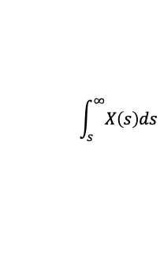
Common Laplace transform pairs
f(t)
F(s)
f(t)
F(s)
1
ω
_{s}2
_{e}−at
t _{t}2
_{te}−at
e^{−at} sin (ωt) e^{−at} cos (ωt)
sin ωt
cos ωt
tx (t) −^{dX (s)}
ds
_{t}
x(t)
δ (t) 1
1 (t)
2
+_{s} ω
s + a
1
s² + ω²
_{s}2
2
_{s}3
$$\int_{s}^{∞}{X\left(s\right)ds}$$
1
(s + a)²
ω
(s + a)² + ω²
1
s
s + a
(s + a)² + ω²
Laplace Transform

